Slide 1
Wednesday, August 2, 2016
Write In Your Agenda:
Write In Your Monitoring Log:
CW:
Volume notes
Liquid volume activity
HW:
None
Response to Warm-Up:
What does the word “volume” mean to you? How would you define it?
You will need:
Pencil
Agenda
Metric System Note Sheet

Slide 2
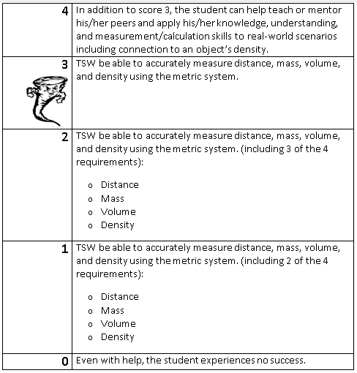
Learning Goal and Scale
TSW be able to describe how the Earth is connected to and affected by other objects in the solar system (including its movement, its relative position to other objects, its seasons, and visible constellations).

